Slide 1


CYBER SECURITY & APPLIED CRYPTOGRAPHY
Module introduction and overview
Er. Prakash Chandra Adhikari

Slide 2
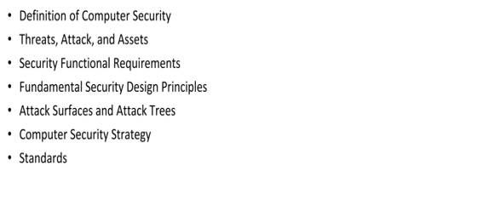
Outline

Slide 3
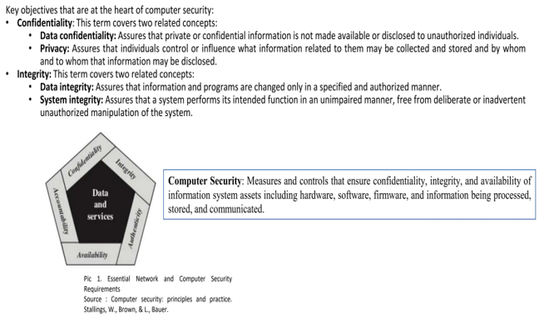
Definition of Computer Security

Slide 4
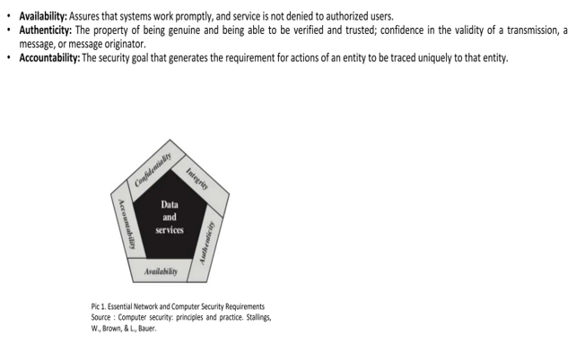
Computer Security (cont.)

Slide 5
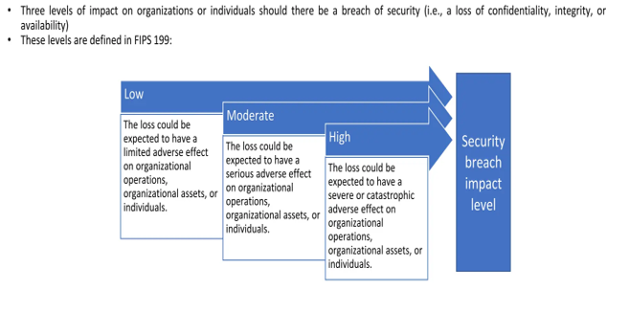
Computer Security (cont.)

Slide 6
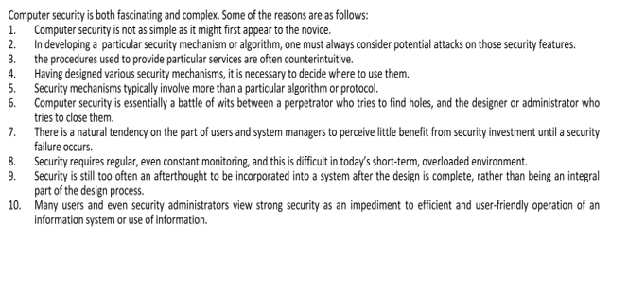
Challenges of Computer Security

Slide 7
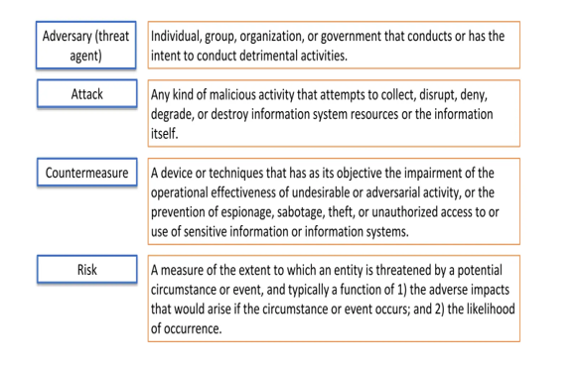
Terminology of Computer Security

Slide 8
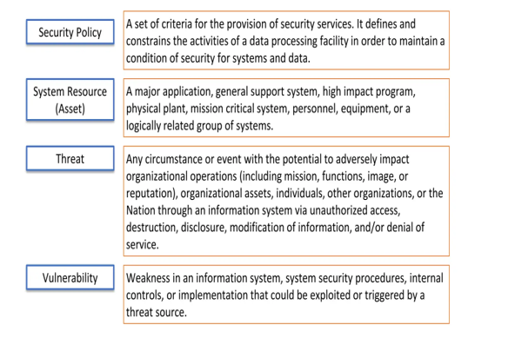
Terminology of Computer Security

Slide 9
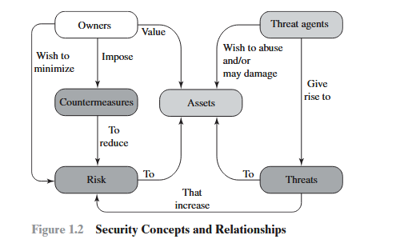
Security Concepts & Relationship

Slide 10
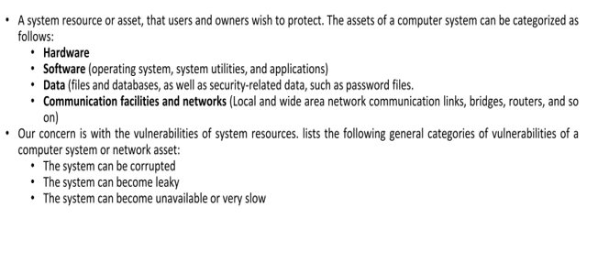
Model for Computer Security

Slide 11
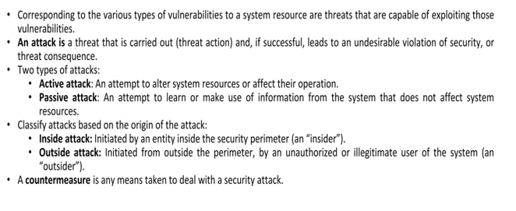
Model for Computer Security

Slide 12
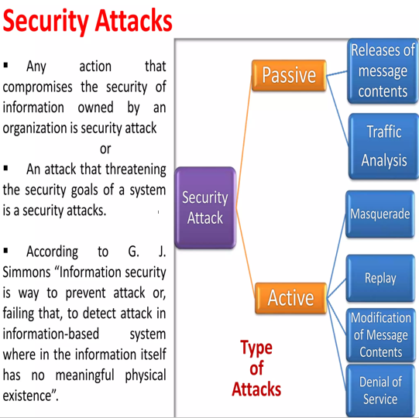
Types of Security Attacks

Slide 13
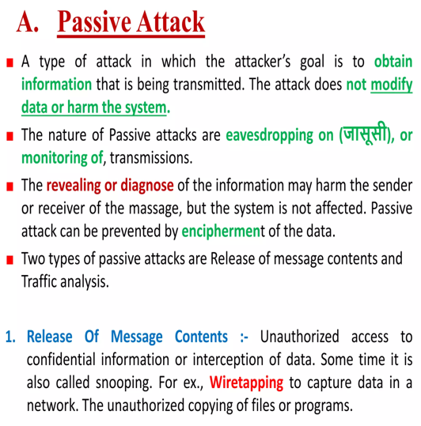
Types of Security Attacks

Slide 14
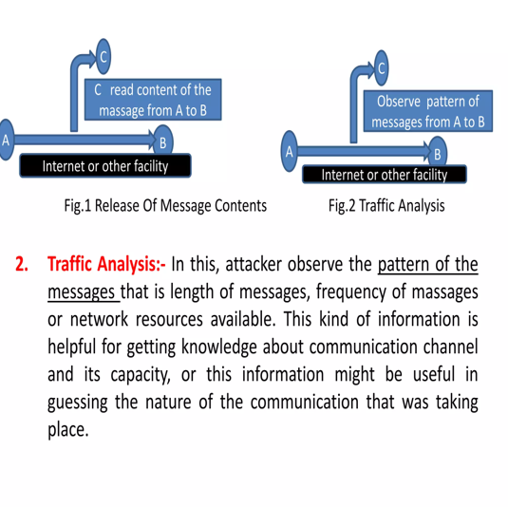
Types of Security Attacks

Slide 15
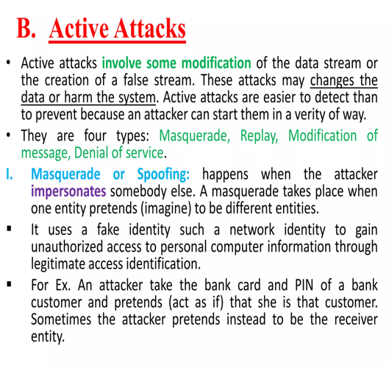
Types of Security Attacks

Slide 16
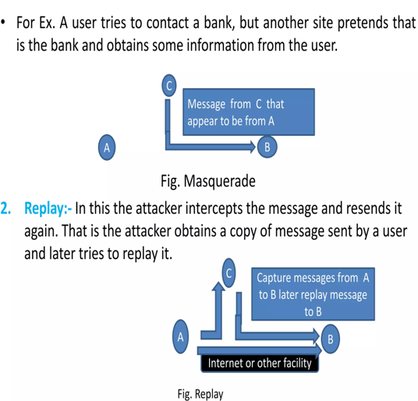
Types of Security Attacks

Slide 17
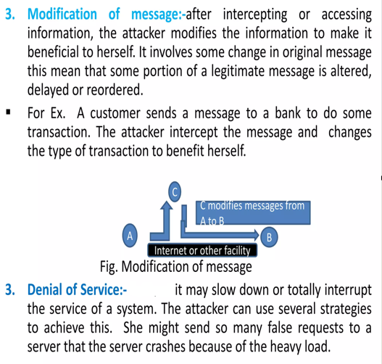
Types of Security Attacks

Slide 18
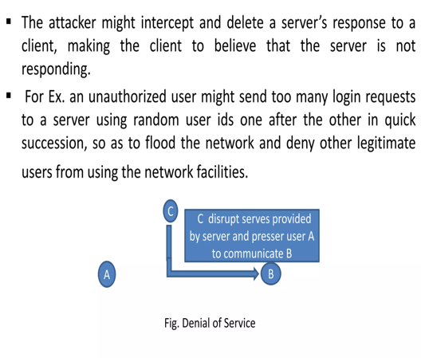
Types of Security Attacks

Slide 19
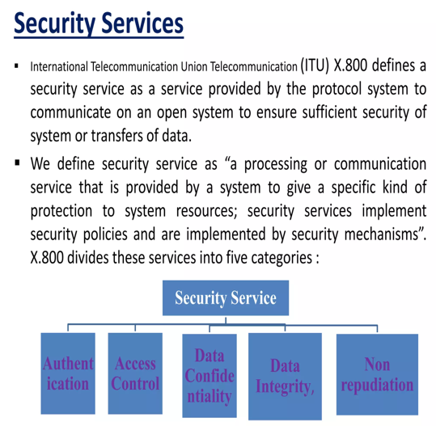
Security Services

Slide 20
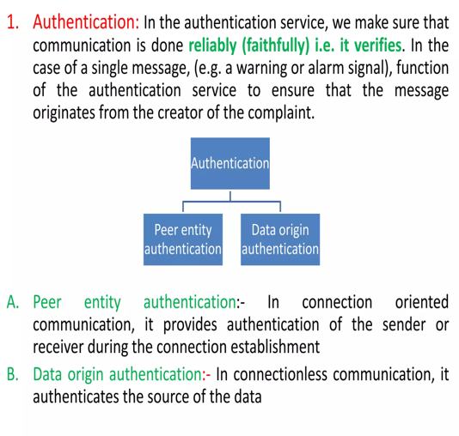
Security Services

Slide 21
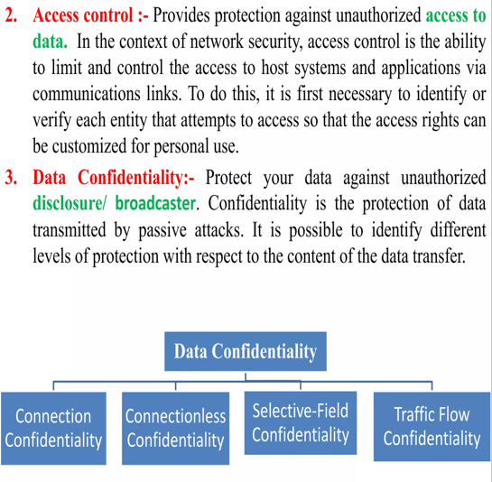
Security Services

Slide 22
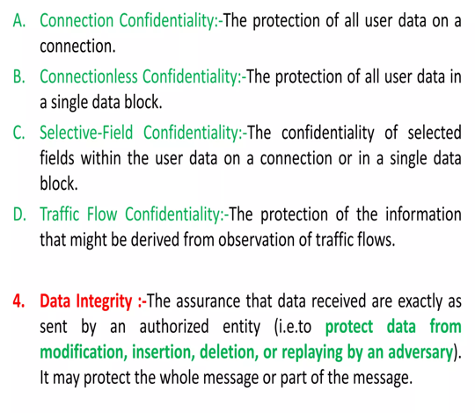
Security Services

Slide 23
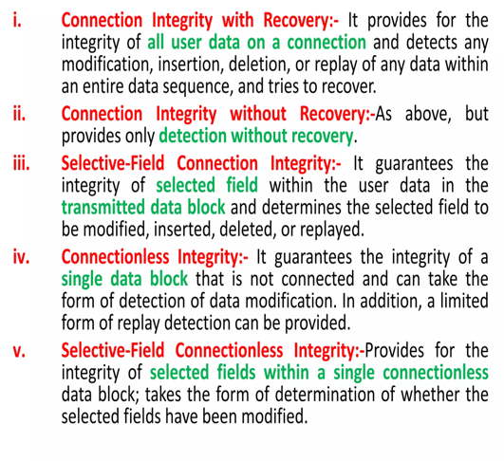
Security Services

Slide 24
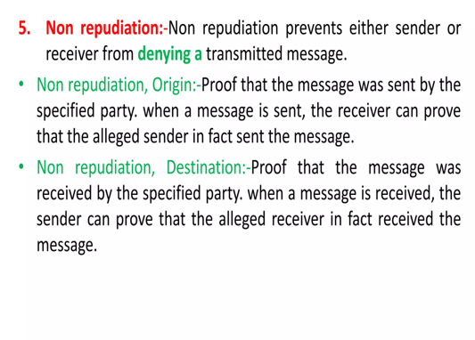
Security Services

Slide 25
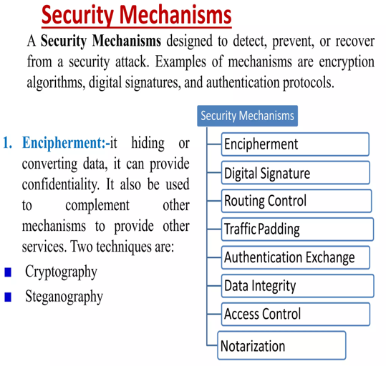
Security Mechanism

Slide 26
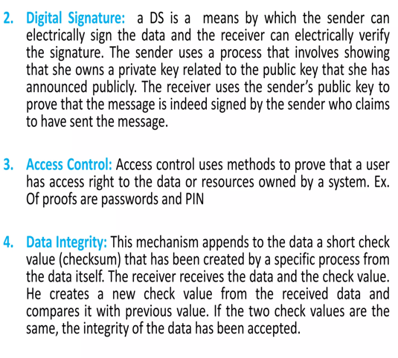
Security Mechanism

Slide 27
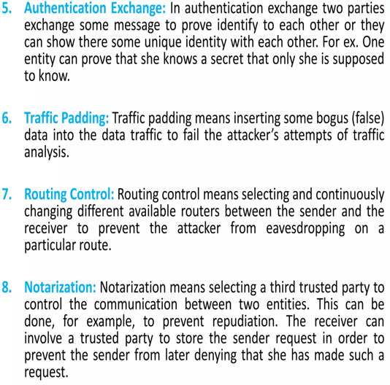
Security Mechanism

Slide 28
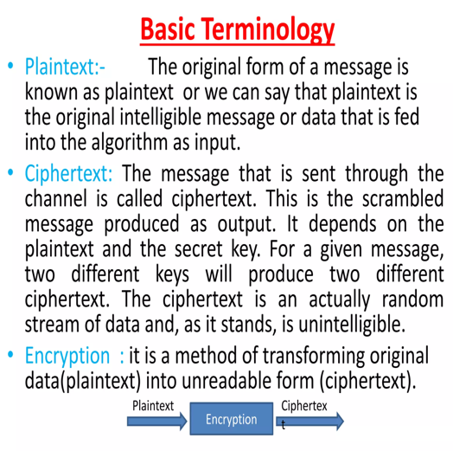
Basic Terminology

Slide 29
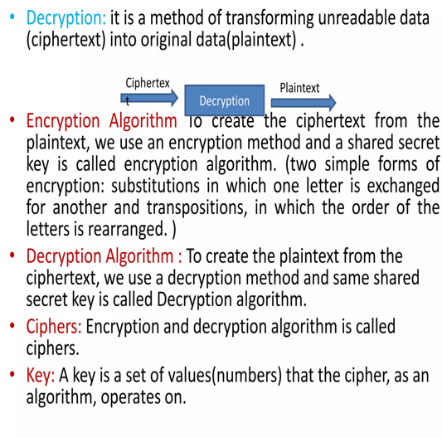
Basic Terminology

Slide 30
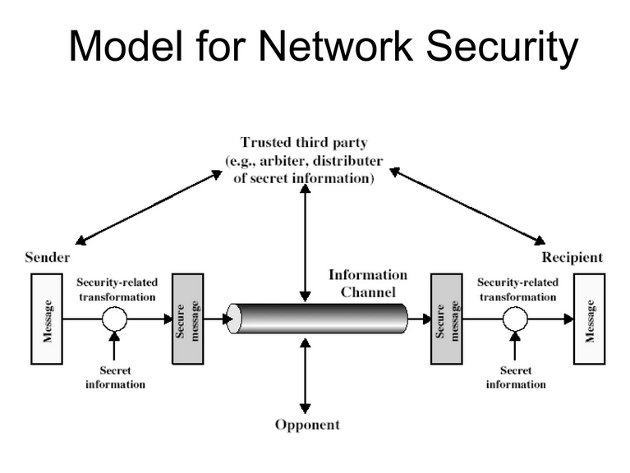
Network Security Model

Slide 31
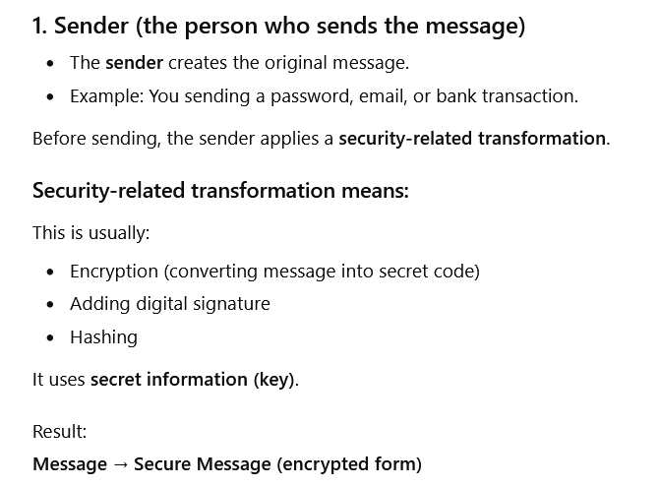
Network Security Model
how a message is safely sent from a sender to a recipient while protecting it from attackers.

Slide 32
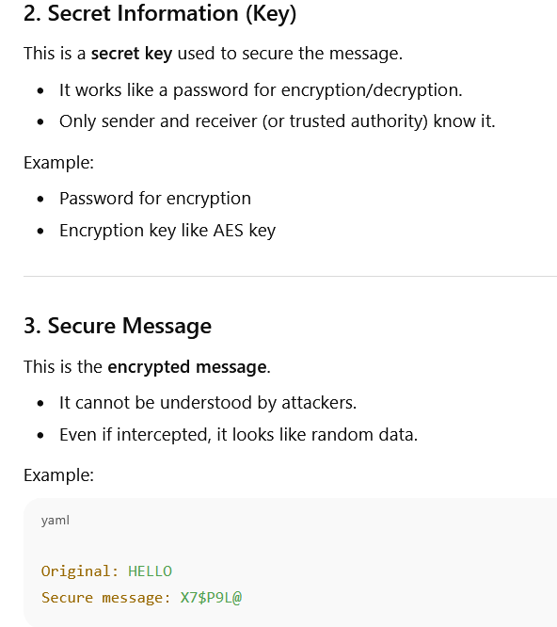
Network Security Model

Slide 33
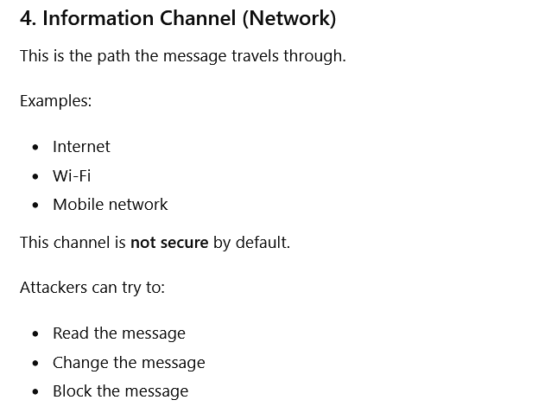
Network Security Model

Slide 34
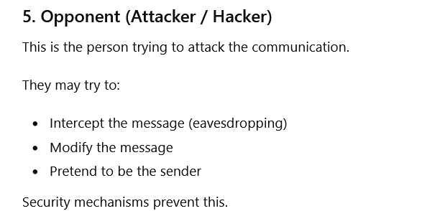
Network Security Model

Slide 35
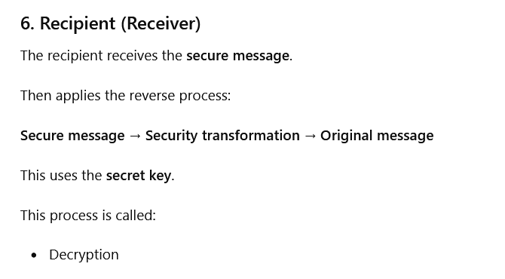
Network Security Model

Slide 36
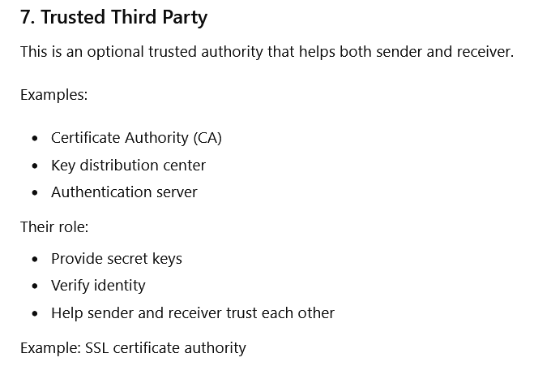
Network Security Model

Slide 37
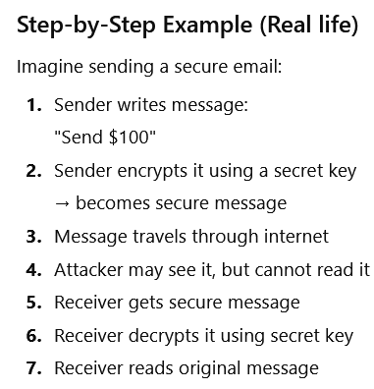
Network Security Model

Slide 38
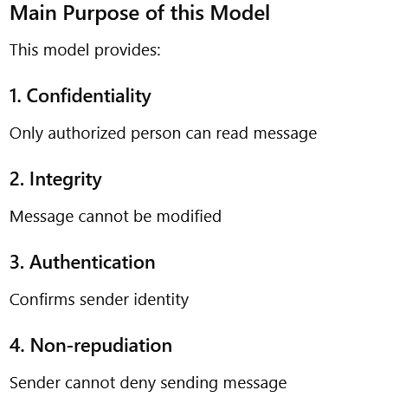
Network Security Model

Slide 39
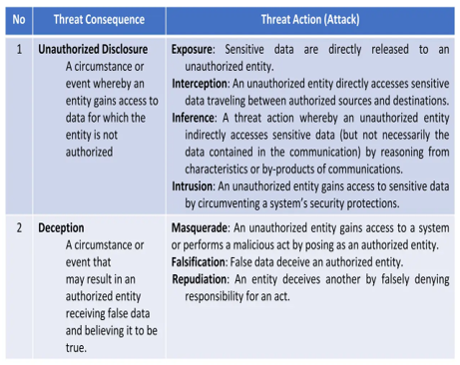
Threats & Attacks

Slide 40
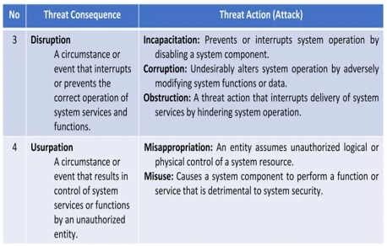
Threats & Attacks

Slide 41
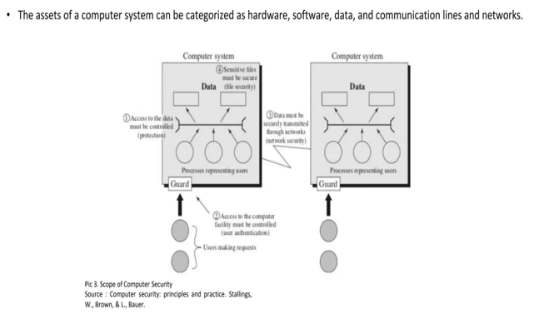
Threats & Attacks

Slide 42
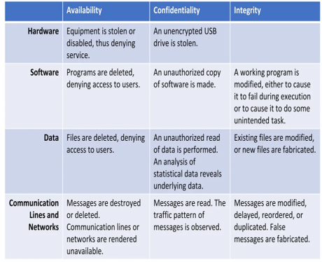
Computer & Network Assets,with Examples

Slide 43
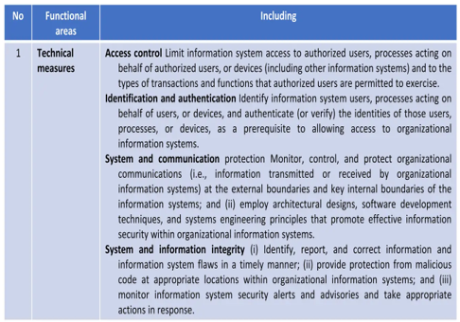
Security Functional Requirements

Slide 44
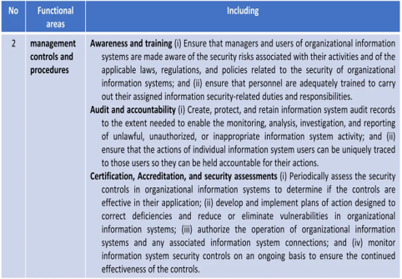
Security Functional Requirements

Slide 45
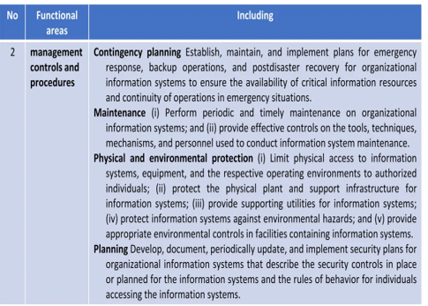
Security Functional Requirements

Slide 46
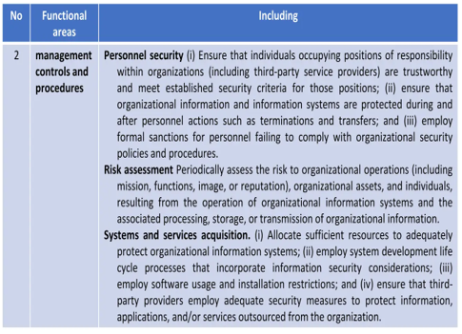
Security Functional Requirements

Slide 47
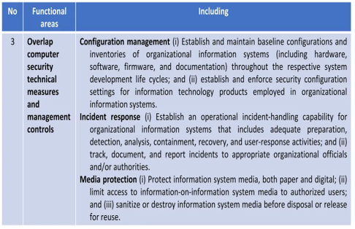
Security Functional Requirements

Slide 48
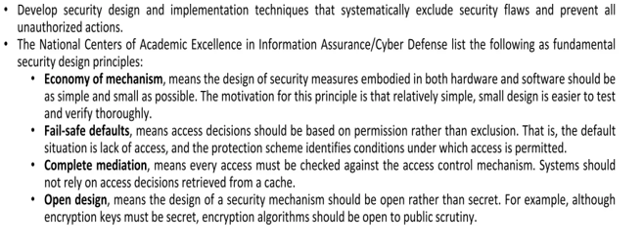
Fundamental Security Design Principle

Slide 49
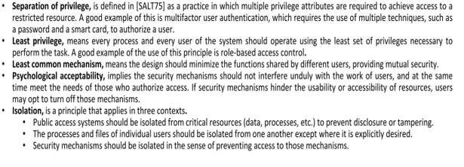
Fundamental Security Design Principle

Slide 50
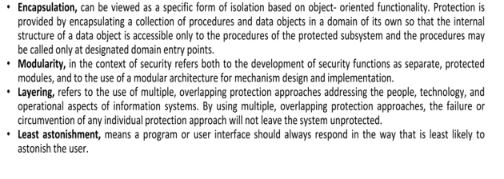
Fundamental Security Design Principle

Slide 51
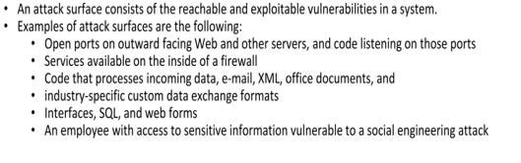
Attack Surfaces

Slide 52

Attack Surfaces

Slide 53

Attack Trees

Slide 54

Attack Trees

Slide 55

Attack Trees

Slide 56

Security Policy

Slide 57

Security Implementation

Slide 58

Security Assurance

Slide 59

Standards

Slide 60

References

